Slide 1
Post-Global Fund HIV Financing: A Promising Transitioning Model and the Implementation of Plan from the SHIFT Project in Thailand
26 July 2018
Rapeepun (Ohm) Jommaroeng, PhD
SHIFT Program Manager
Email: rapeepun@thaiaids.org

Slide 2
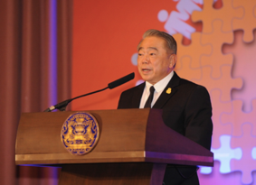
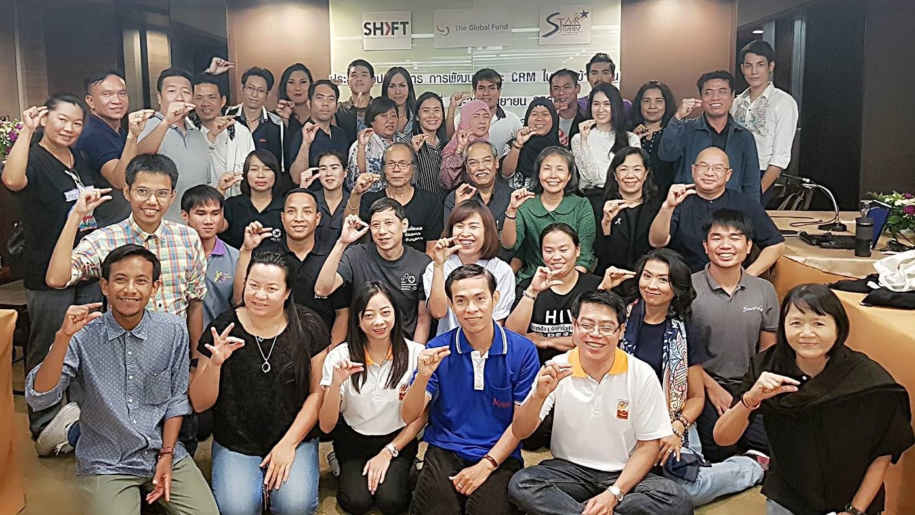
What is needed for the transition?
Thai Deputy
Prime Minister at
AIDS- Almost Zero Grand Opening
8 May 2017
Political commitment
Strong civil society sector
Knowledge of public policy system and governance
No previous negative relationship between GOs and CSOs (if so, solve this first – by a neutral third party)
CSO Resource Mobilization Coalition

Slide 3
Vision: To End AIDS in 2030 (in 14 years)
Situations: Concentrated HIV epidemic among key populations
New infections < 1,000 cases
Deaths due to HIV < 4,000 cases
PLHIV 400,000 persons
Support from SHIFT
Actions from the Civil Society Sector: ”AIDS Almost Zero” Program
CSO Funding Mechanism
Strategic information
Working with the Government
National Health Security Office (US$5.7M per year for key populations)
MoPH Subsidiary funds (US$1.42M per year)
CRM Coalition
(Civil Society Organization
Resource
Mobilization)
Fundraising with
Private Sector
and philanthropists
Capacity building
Increased fiscal space
Strengthen Formal and Informal Partnership
Allocative Efficiency
Collaborative Governance
Transitioning Plan
Policy Advocacy
Participatory Budgeting
Sharing among countries
Shared responsbilities

Slide 4
Key Success Factors for Domestic HIV Financing for Civil Society Organizations (some could be prerequisite assumptions/conditions)
Strengthened both formal and information partnership/relationships + shared vision
CSOs – Professional, Legitimacy, Accountability, and Management proficiency
Reliable strategic information (being a good source)
Communication consistency in partnership
Strong collective voices of CSOs
Respect government staff as equal humans (and hopefully they would do the same)

Slide 5
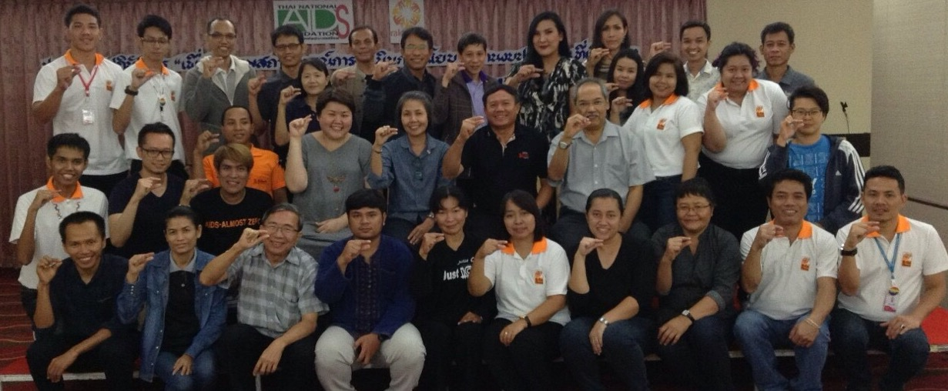
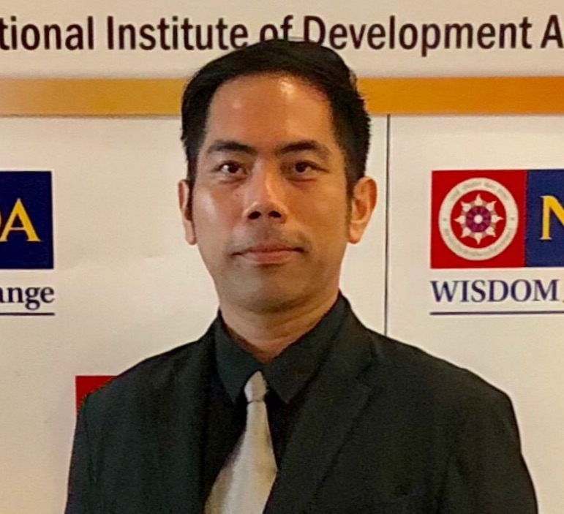
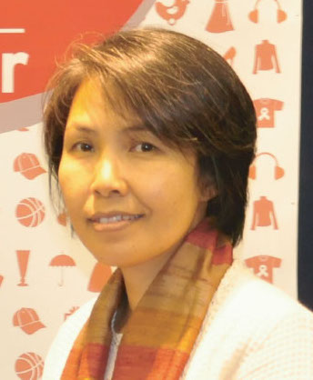
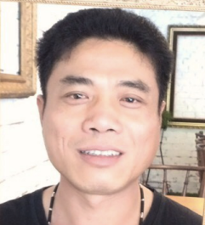
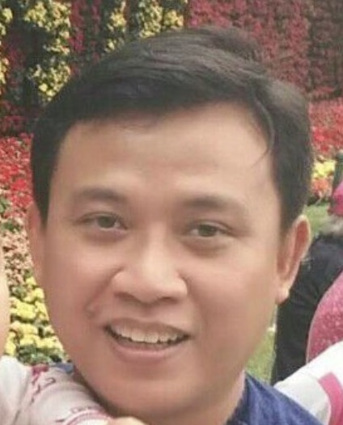
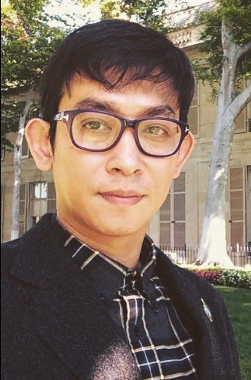
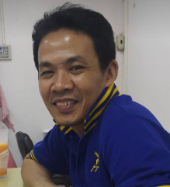
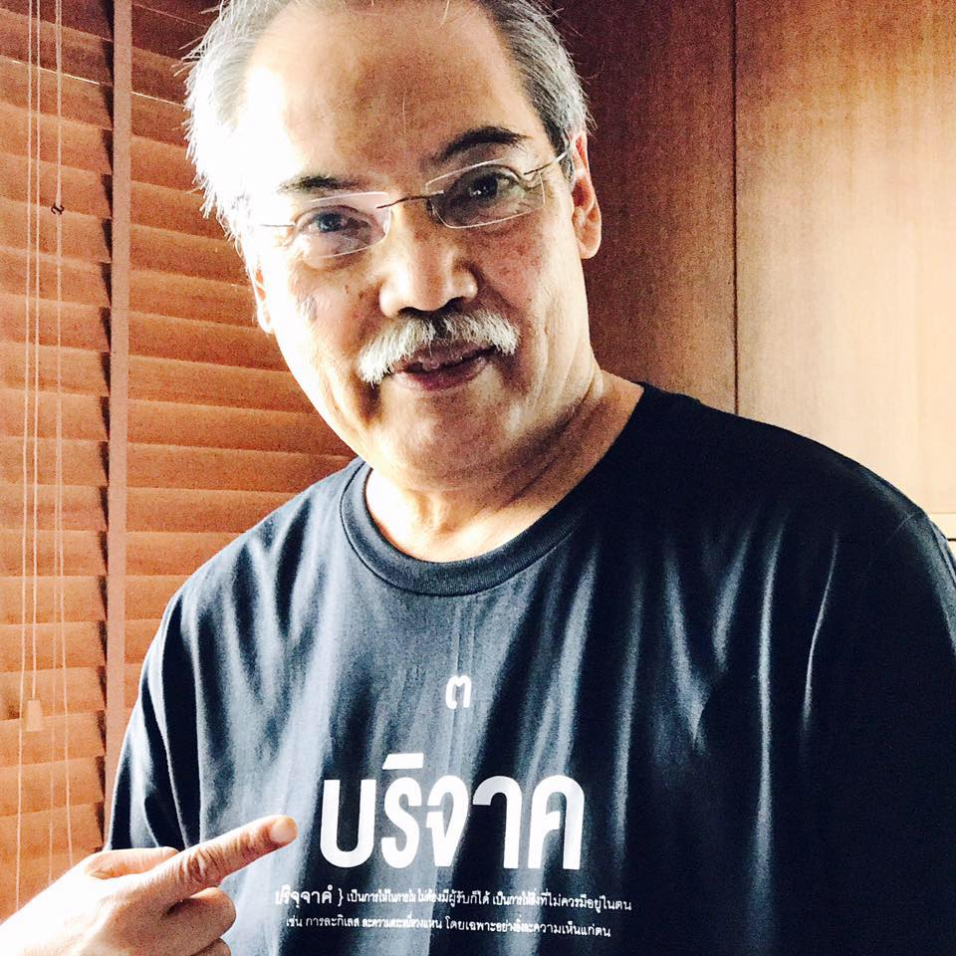
You can’t win a boxing match
by just yelling at the side ring.
You have to go up on the STAGE!
Authors:
Rapeepun Jommaroeng^{1,2}, Yenjit Somphoh¹, Kamon Uppakaew¹, Aggamorn Karakit¹,
Danai Linjongrut¹, Choovit Thongbai³, Promboon Panitchpakdi¹
and the CSO Resource Mobilization (CRM) Coalition
¹ Thai National AIDS Foundation, ² Rainbow Sky Association of Thailand,
³ Pink Monkey Lopburi, ⁴ Raks Thai Foundation

